Slide 1

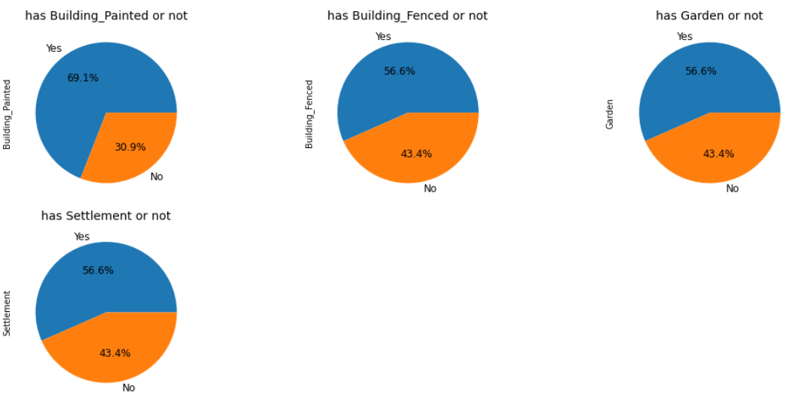
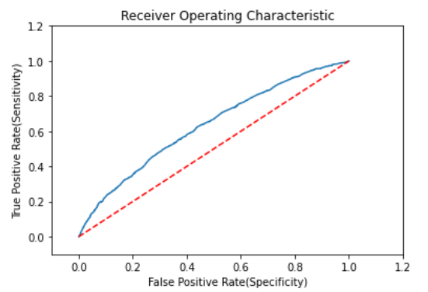
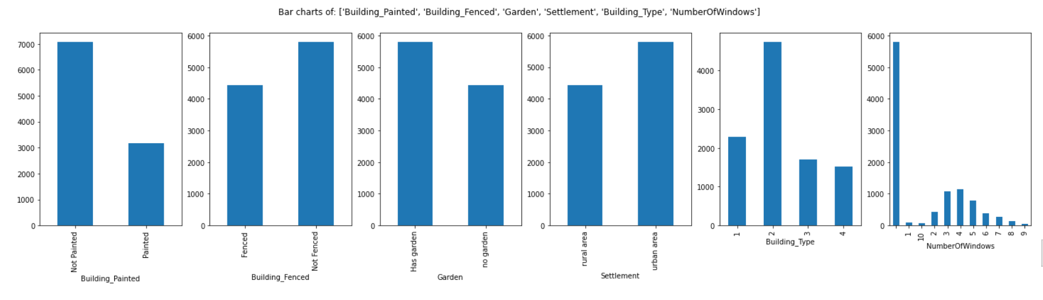
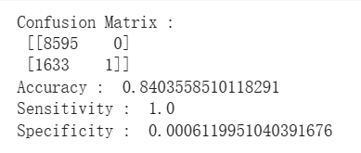
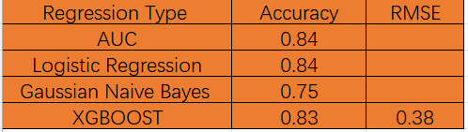
Construction Insurance Prediction
Yinyi Du
Mentor: Dr. Christelle Scharff
Pace University, Seidenberg School of CSIS
Github: https://bit.ly/3n7rRTG
Notebook: https://bit.ly/3L6b8ba
Abstract
Experiments
Methodology
Conclusions &
Future Work
Area Under the Curve (AUC) was the evaluation metric used to calculate construction insurance claims. Most of buildings did not have a claim over the insured period. The accuracy of this method was high which was 84%. The value of sensitivity was 1.0, and specificity was 0.0006.
Logistic regression can help to estimate the probability of an insurance claim occurring based on a given dataset of building variables.
Gaussian Naive Bayes (GNB) helps to predict the probability based on building attributes.
XGBoost is a regression predictive modeling which has better results based on four evaluation indicators namely accuracy, sensitivity, specificity, and precision.
The suggested research's goal is to build a predictive model to determine if a building in major cities in Nigeria will have at least one insurance claim during a certain period of time. Logistic regression model, Gaussian Naive Bayes were some of the regression models employed in this research. Area Under the Curve was implemented as evaluation metric to calculate the probability of having claim. After comparing the accuracies, it was determined that logistic regress model was the most accurate of all the methods, with an accuracy of 84%. Finally, the claim results were calculated using the AUC for each building based on the best model.
Research Question
Can we predict if a building will have at least one insurance claim during a certain period or not in Lagos and Nigeria?
Related Work
Existing research has shown that the use of machine learning can predict medical insurance claims and costs [D, 2022]. Several papers have focused on using logistic regression models [Jyothsna, 2022] to compare the personal’s healthy attributes [Aggarwal,2022] to predict medical insurance claims[Dutta,2021].
Dataset
The dataset was obtained from Zindi (https://zindi.africa/competitions/insurance-prediction-challenge/data). The dataset contained insurance data from 2012-2016. It had 10k rows and 14 columns including building attributes such as building painted, settlement, date of occupancy and building type. Categorial columns such as “Building_Painted”, “Building_Fenced”, “Garden” and “Settlement” were replaced by full text. Punctuation was removed from “NumberOfWindows”. “Building Dimension” and “'Date of occupancy” were converted from float to int for further analysis.
Most buildings have painted, fenced, garden and settlement.
Overall, construction insurance data was conducted to be analyzed using three regression models. A comparison was made between the predicted probability generated by the three regression models and the actual probability to evaluate how accurate they were. In order to improve the reliability of construction insurance demand forecasting, a construction insurance probability forecasting model based on logistic regression was proposed. The logistic regression model was proved to be the most effective. The model had high prediction accuracy which was 84%. Therefore, it showed that the proposed prediction model based on logistic regression could better meet the requirements of construction insurance demand prediction and the claim probability results had high possible of accuracy.
References
C. Jyothsna, K. Srinivas, B. Bhargavi, A. E. Sravanth, A. T. Kumar, J. S. Kumar (2022). Health Insurance Premium Prediction using XGboost Regressor, International Conference on Applied Artificial Intelligence and Computing (ICAAIC), DOI: 10.1109/ICAAIC53929.2022.9793258
L. Qin, B. Liu (2022). Agricultural insurance demand forecasting model based on support vector machine, 14th International Conference on Measuring Technology and Mechatronics Automation (ICMTMA), DOI：10.1109/ICMTMA54903.2022.00149
R. D,M. S. K, D. J (2022). Health Insurance Cost Prediction using Machine Learning Algorithms, International Conference on Edge Computing and Applications (ICECAA), DOI: 10.1109/ICECAA55415.2022.9936153
N V. Sailaja, M. Karakavalasa, M. Katkam, D. M, S. M, D. N. Vasundhara (2021). Hybrid Regression Model for Medical Insurance Cost Prediction and Recommendation, IEEE International Conference on Intelligent Systems, Smart and Green Technologies (ICISSGT), DOI: 10.1109/ICISSGT52025.2021.00029
Izonin, R. Tkachenko, N. Kryvinska, M. Gregus, P. Tkachenko, P. Vitynskyi (2019). Committee of SGTM Neural-Like Structures with RBF kernel for Insurance Cost Prediction Task, IEEE 2nd Ukraine Conference on Electrical and Computer Engineering (UKRCON), DOI: 10.1109/UKRCON.2019.8879905
S. Aggarwal, Anmol (2022). Health Insurance Amount Prediction Using Supervised Learning, 2nd International Conference on Technological Advancements in Computational Sciences (ICTACS), DOI: 10.1109/ICTACS56270.2022.9988256
K. Dutta, S. Chandra, M. K. Gourisaria, H. GM (2021). A Data Mining based Target Regression-Oriented Approach to Modelling of Health Insurance Claims, 5th International Conference on Computing Methodologies and Communication (ICCMC), DOI: 10.1109/ICCMC51019.2021.9418038
J. B, A. Ghosh, J. A. K. R (2022). End-to-End Encryption and Prediction of Medical Insurance Cost, 6th International Conference on Trends in Electronics and Informatics (ICOEI), DOI: 10.1109/ICOEI53556.2022.9777238
Results
Based on the methodology, a building will have an insurance claim during a certain period or not can be predicted in Lagos and Nigeria. At 84%, the accuracy of the expected amount predicted using logistic regression was the best. The logistic regression model was implemented to calculate the probability of having claims. All the other regression models had low accuracy than logistic regression model.

